Slide 1
Hadoop - Theory

Slide 2
Agenda
What is Hadoop
MapReduce
HDFS
How MapReduce works
YARN
Ecosystem Built around Hadoop

Slide 3
What is Hadoop
Hadoop is a framework that is used to store and process large datasets.
HDFS – Distributed Storage
MapReduce – Distributed Compute

Slide 4
Distributed Storage
CPU + RAM
Disk
200GB
200GB
200GB
200GB
Metadata Node / Master Node
CPU + RAM
CPU + RAM
CPU + RAM
CPU + RAM
Disk
Disk
Disk
Disk
Data Nodes

Slide 5
HDFS
NameNode
Metadata
Default Block Size = 128MB
DataNode1
DataNode2
DataNode3
DataNode4

Slide 6
HDFS – Read Path
Read
HDFS Client
NameNode
Available in Data Nodes 1,2 & 4
DataNode1
DataNode2
DataNode3
DataNode4

Slide 7
HDFS – Write Path
Where to store
HDFS Client
NameNode
Store in Data nodes 2,1 and 4
DataNode1
DataNode2
DataNode3
DataNode4

Slide 8
MapReduce
Programming model/framework that does distributed processing of (distributed) data.
Programming languages – Java, Python, Ruby.
The framework does a lot of work for us.
Two main phases:
Map
Reduce

Slide 9
Map and Reduce
Processing is done in two phases – Map and Reduce.
Map function (written by developer).
Reduce function (written by developer).
Input to Map phase is the raw file.
Input to Reduce phase is output of Map.
Input File in HDFS
Output File in HDFS
Map
Reduce
Output

Slide 10
Map
(K1, V1) → List(K2, V2)
Map Function
(user written)
Key-Value records

Slide 11
Reduce
(K2, List(V2)) → List(K2, V3)
Reduce Function
(user written)
Aggregated Output
Key-Value records

Slide 12
How MapReduce Works
Output
(key-value records)
Input File
Split 1
Map Task 1
Disk
p1
Reduce Task 1
p2
Reduce Task 2
Split 2
Map Task 2
Disk
p3
Reduce Task 3
p4
Reduce Task 4
Split 3
Map Task 3
Disk
p5
Reduce Task 5
Split Size = HDFS block size (128MB)
Local Disk

Slide 13
How MapReduce Works
Partition by Key
Maintain sort order
Map Output 1
Sort by Key
p1
merge
Reduce Task 1
p2
merge
Reduce Task 2
Map Output 2
Sort by Key
merge
Reduce Task 3
p3
p4
merge
Reduce Task 4
Map Output 3
Sort by Key
p5
merge
Reduce Task 5
Key-value output
Copy phase
Partitioner
Shuffle phase
Map Side
Reduce Side

Slide 14
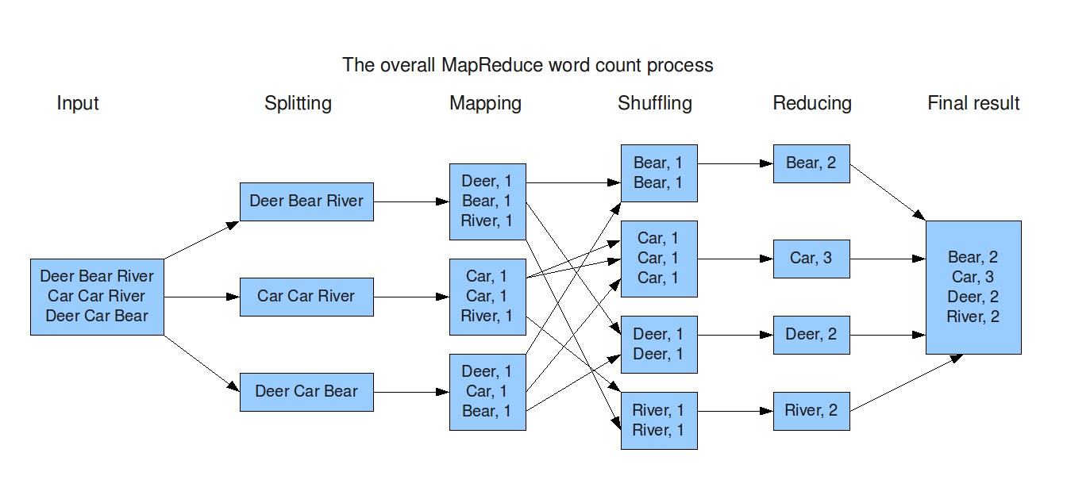
How MapReduce Works - Example

Slide 15
Partitioner
Creates partitions for each reducer.
No. of partitions = No. of reducer tasks.
Same key will land on the same partition.
Two types:
Default partitioner – Uses hash function to put records in partitions.
Custom partitioner – User created.

Slide 16
Combiner
Mini reducer.
Run at map side on mapper outputs.
Reduces the output on mapper that have to be moved by generating aggregated output on each map output.
File
Map
Map output
Sort by key
Combiner
Partitioner
Input from mapper
Merge & maintain sort order
Reduce Function
Output

Slide 17
Distributed Processing
Client
CPU + RAM
Disk
CPU + RAM
CPU + RAM
CPU + RAM
CPU + RAM
Disk
Disk
Disk
Disk

Slide 18
YARN
Cluster resource manager.
Have APIs to work with cluster resources.

Slide 19
YARN
Resource manager
Node manager1
Node manager2
Node manager3
Node manager4

Slide 20
YARN
Client Applications:
MapReduce
Spark
Submit Application
Resource manager
Need resource
Node Manager
Node Manager
Node Manager
Node Manager
container
container
container
Application Process
Application Master
Application Process

Slide 21
Hadoop Ecosystem
Hive
MapReduce
Tez
Spark
Presto
HBase
YARN
HDFS

Slide 22
Thank You!

